Slide 1
KKBox‘s Churn (or lost, 流失) Prediction Challenge
106356013
游達 （Ta Yu)
Notes:
\

Slide 2
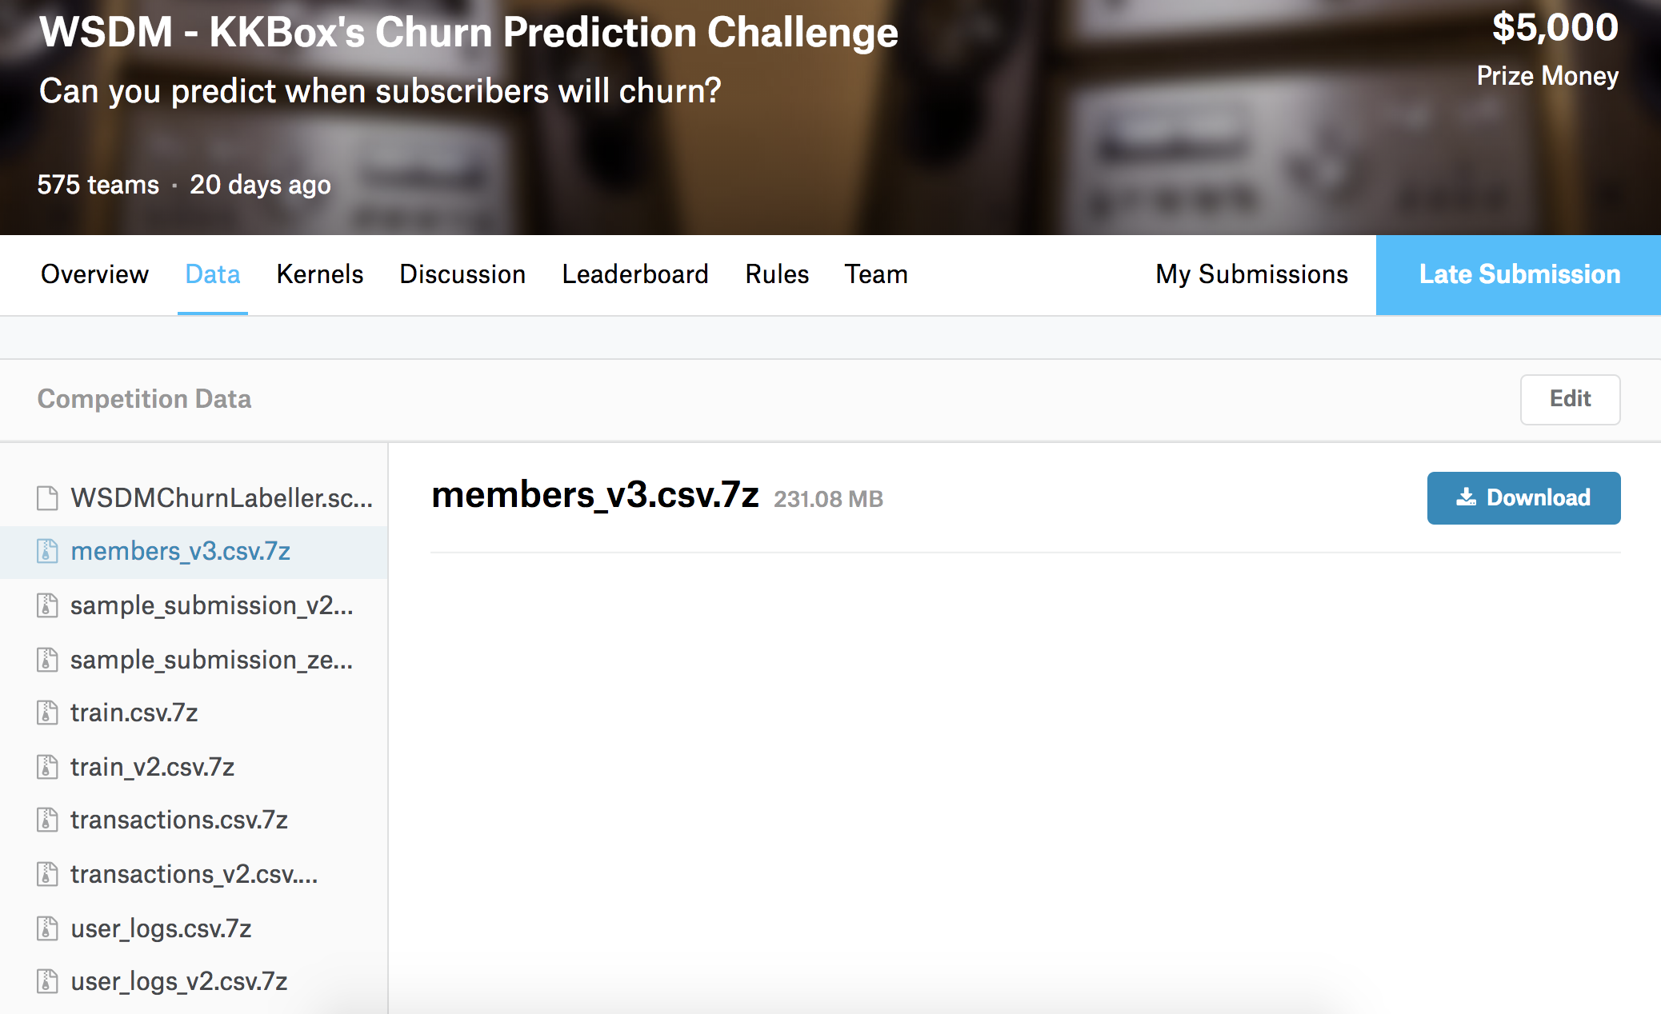
Input
https://www.kaggle.com/c/kkbox-churn-prediction-challenge/data

Slide 3
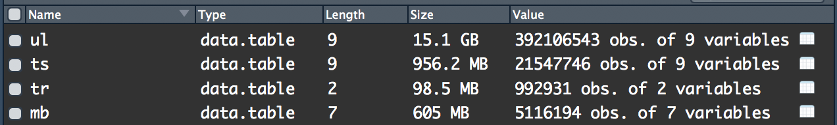
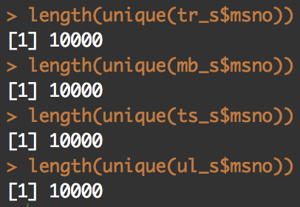
Input
4.User logs
3.Transaction
2.train
1.member
Notes:
5 million members
Randomly drew 10 thousand members for quickly computing

Slide 4
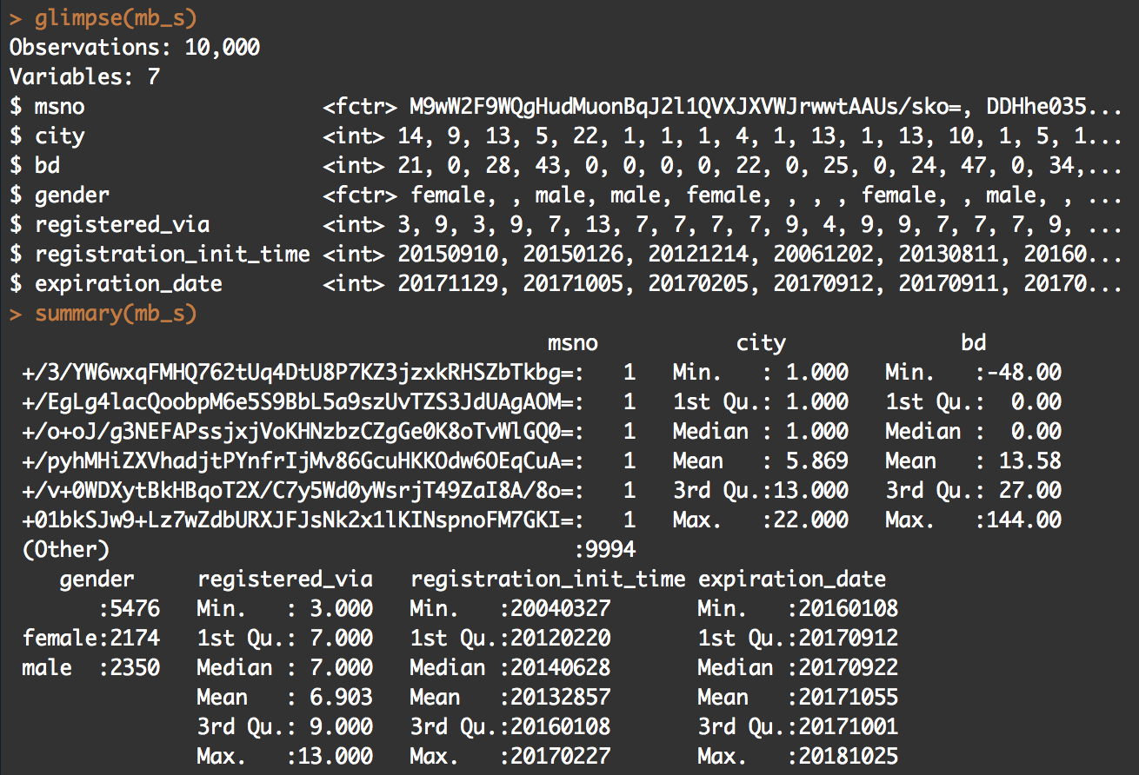
Input
4.User logs
3.Transaction
2.train
1.member
Notes:
Age, gender, how to register, how to pay

Slide 5
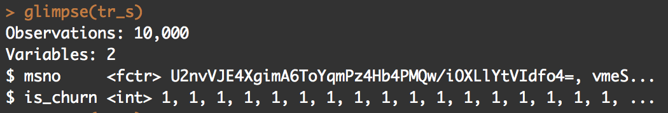
Input
4.User logs
3.Transaction
2.train
1.member
Notes:
One members actually churn or not after their last transaction in march 20 17

Slide 6
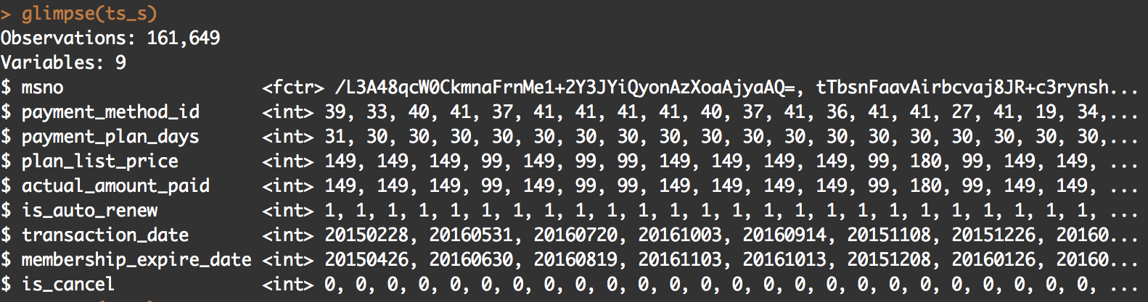
Input
4.User logs
3.Transaction
2.train
1.member
Notes:
How munch one members pay, when is the first payment, have the member canceled auto renew

Slide 7
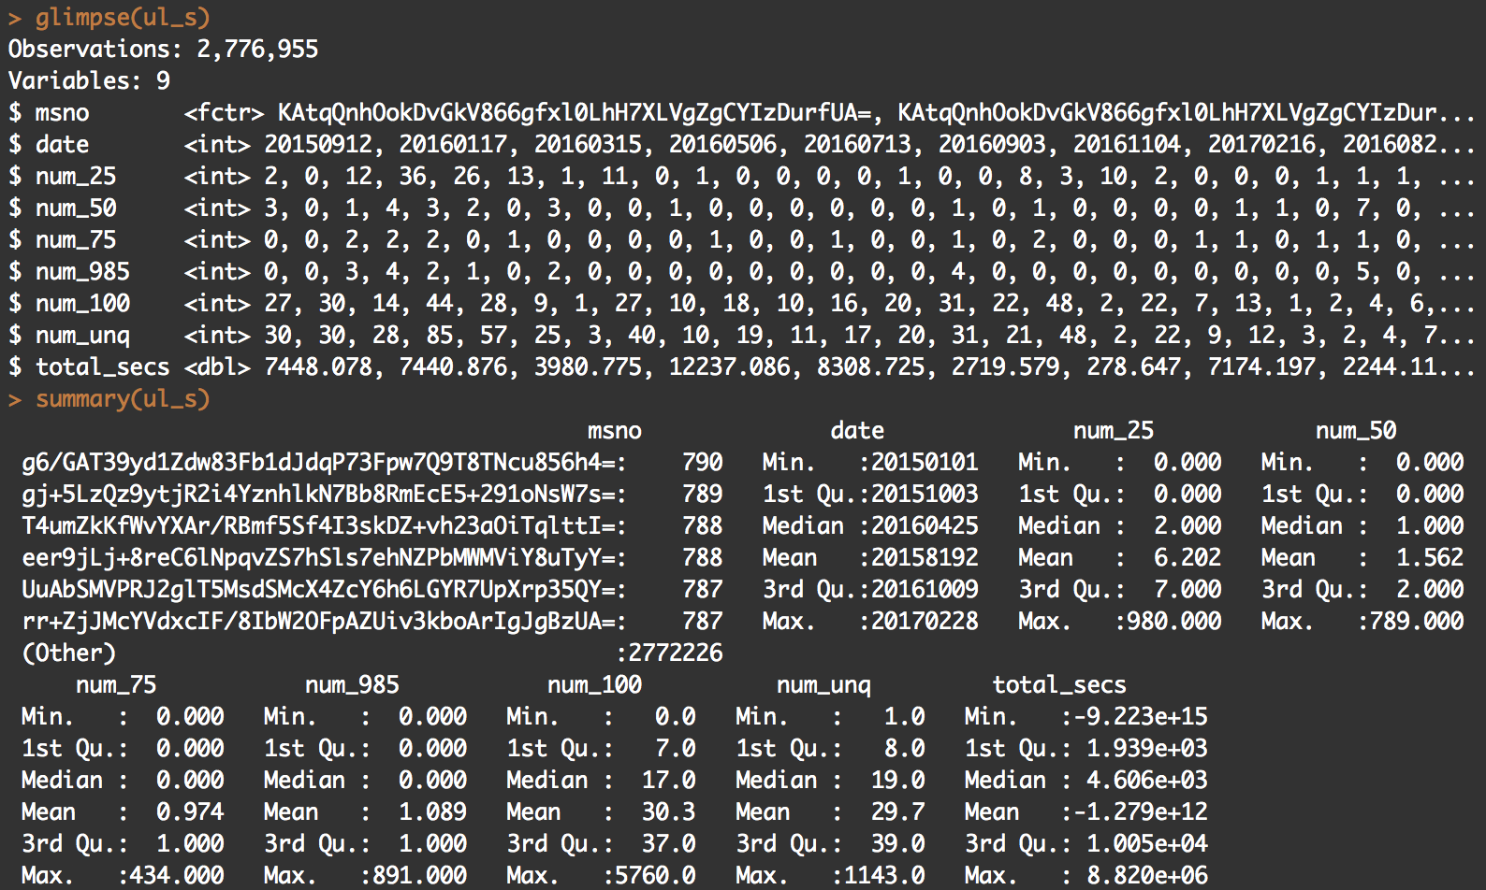
Input
4.User logs
3.Transaction
2.train
1.member
Notes:
Every day, total time did one member play in seconds , how many unique songs did one member play, how many songs did one member just play the 25%, 50%, 75% length of the songs...etc

Slide 8
Scale value
No, Scaling isn't required for logistic regression and random forest
The main goal of standardizing features is to help convergence of the technique used for optimization. For example, if you use Newton-Raphson to maximize the likelihood, standardizing the features makes the convergence faster.

Slide 9
Handle missing data

Slide 10
Handle missing data
Notes:
86 thousands 4 hundral
8.64 by 10 to the 4

Slide 11
Modeling
Which method do you use?
What is a null model for comparison?
How do your perform evaluation?
K fold cross valid / split out. / over fitting problem
Is your improvement significant?

Slide 12
method & evaluation I use
null model
logistic regression
begging logistic regression
Ramdom forests
5 fold cross valid

Slide 13
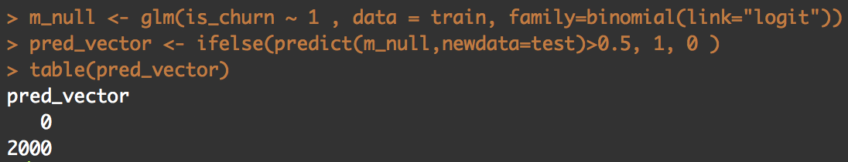
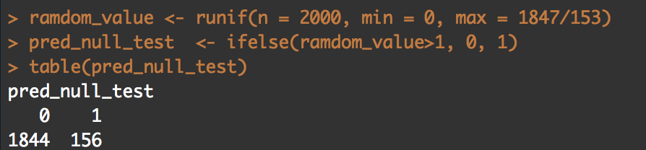
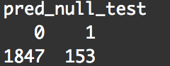
null model

Slide 14
method & evaluation I use
null model
logistic regression
begging logistic regression
Ramdom forests
5 fold cross valid

Slide 15
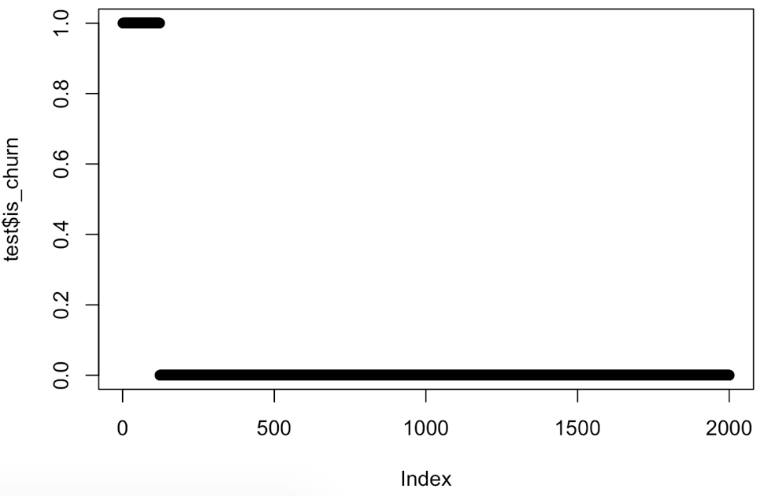
plot(test$is_churn)
Notes:
The first 140 obs

Slide 16
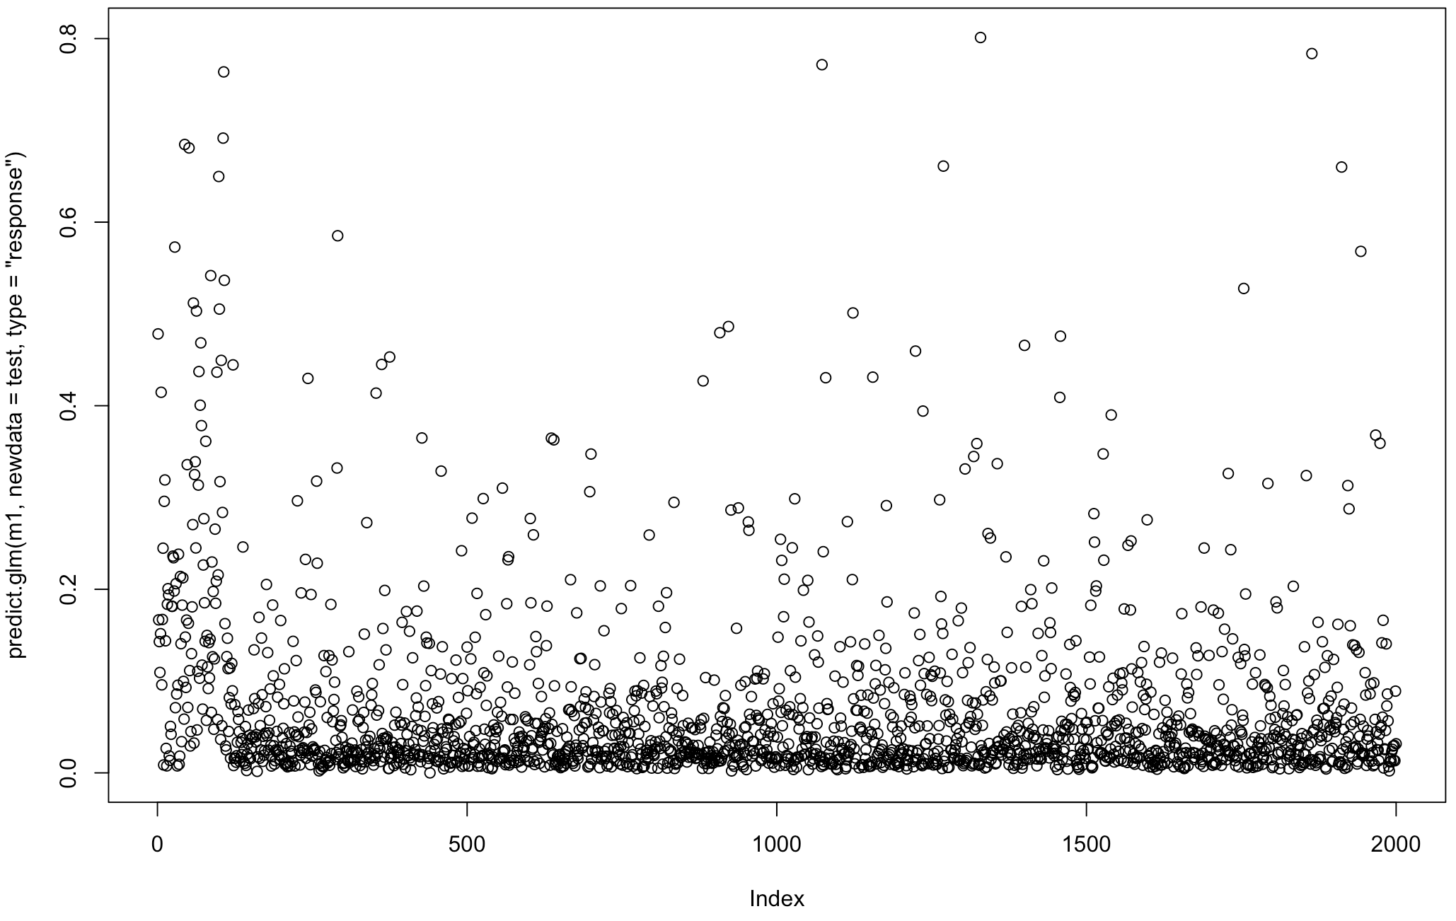
Using logistic regression
Notes:
Acc high
Recall low

Slide 17
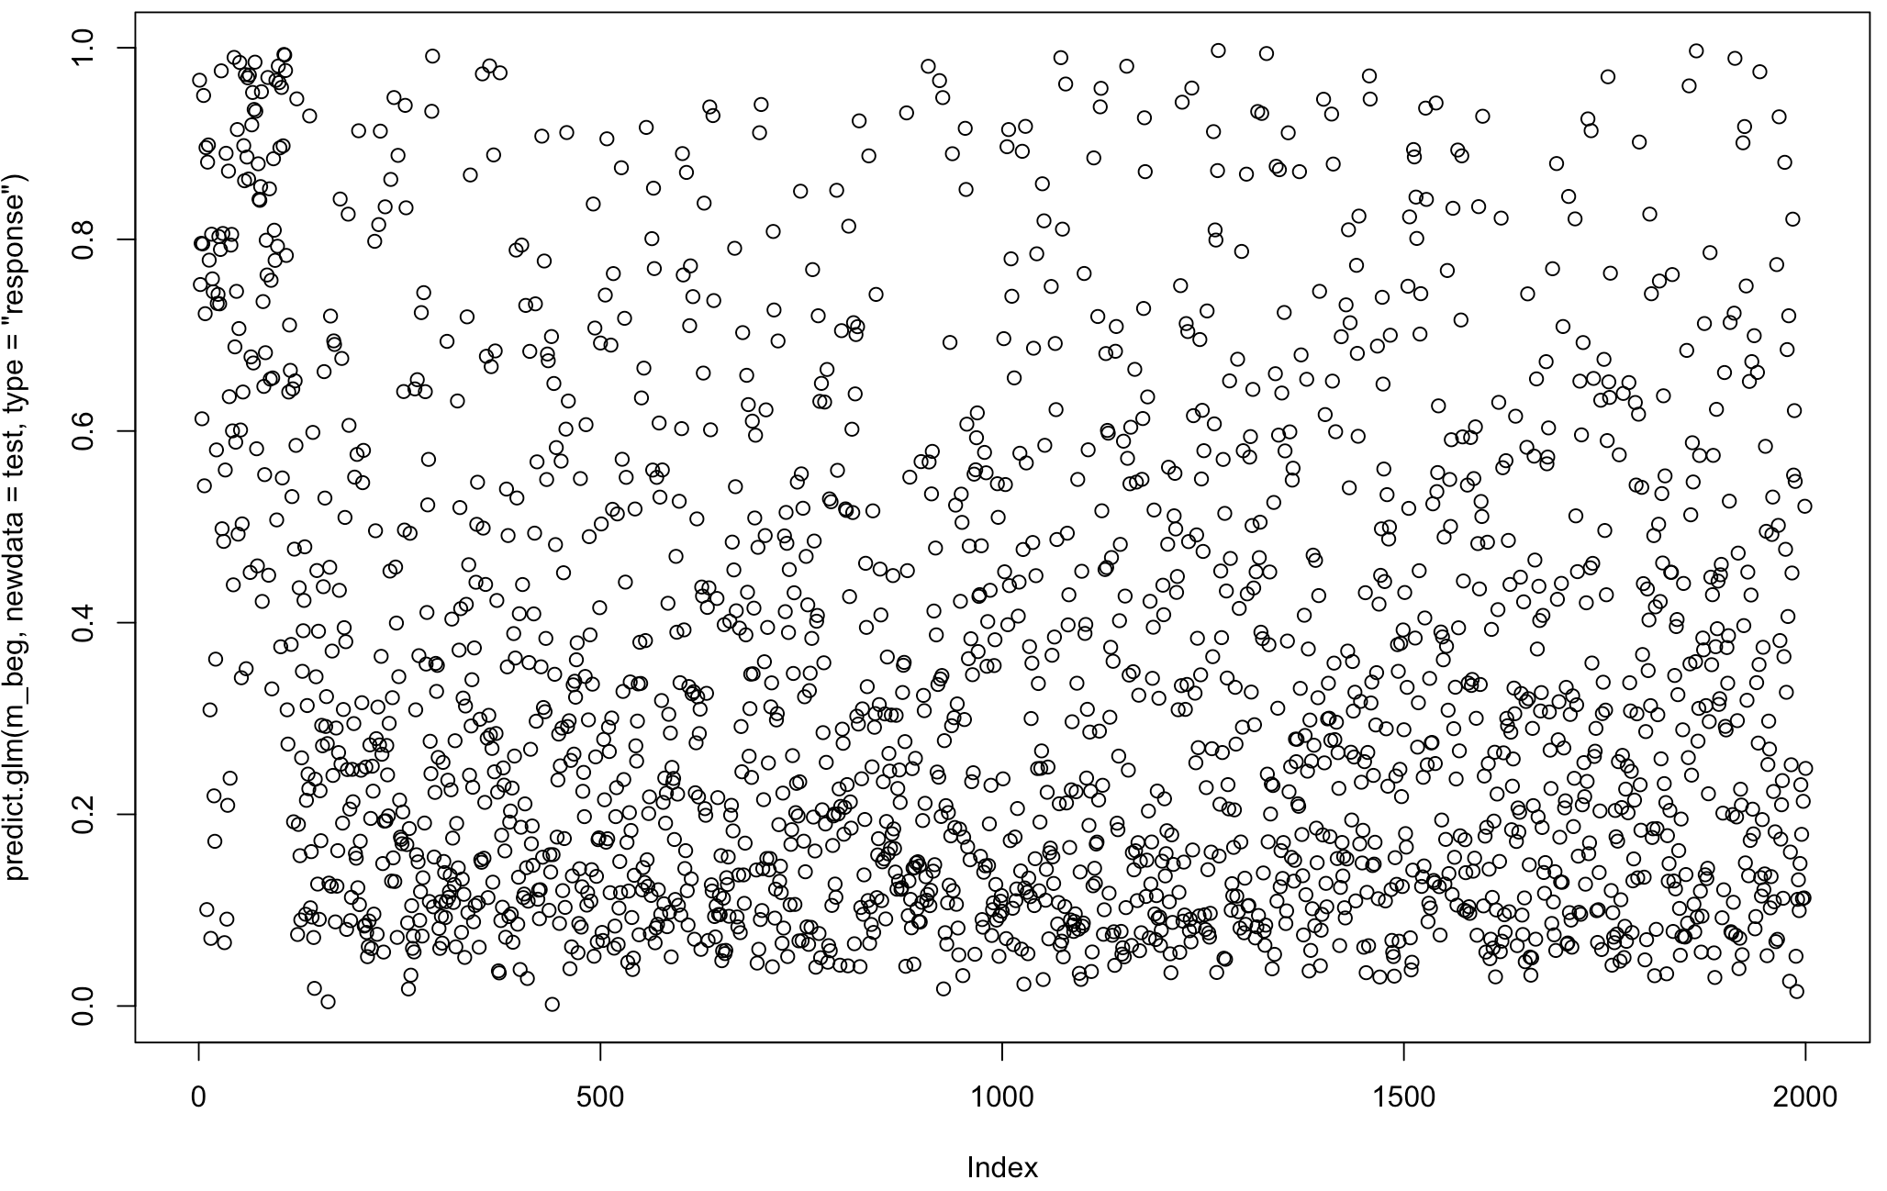
Using begging + logit for imbalanced data
Notes:
Recall, f1 pretty high
But low accuracy

Slide 18
Is the improvement significant?
null model
logistic regression
begging logistic regression
Ramdom forests
5 fold cross valid

Slide 19
Goal
Accuracy Paradox
there is a large class imbalance
Accuracy Paradox
Can easily predict many zero to have high accuracy
I use F1- Measure for the balance between the precision and the recall
in a problem where there is a large class imbalance, a model can predict the value of the majority class for all predictions and achieve a high classification accuracy, the problem is that this model is not useful in the problem domain
https://machinelearningmastery.com/classification-accuracy-is-not-enough-more-performance-measures-you-can-use/

Slide 20
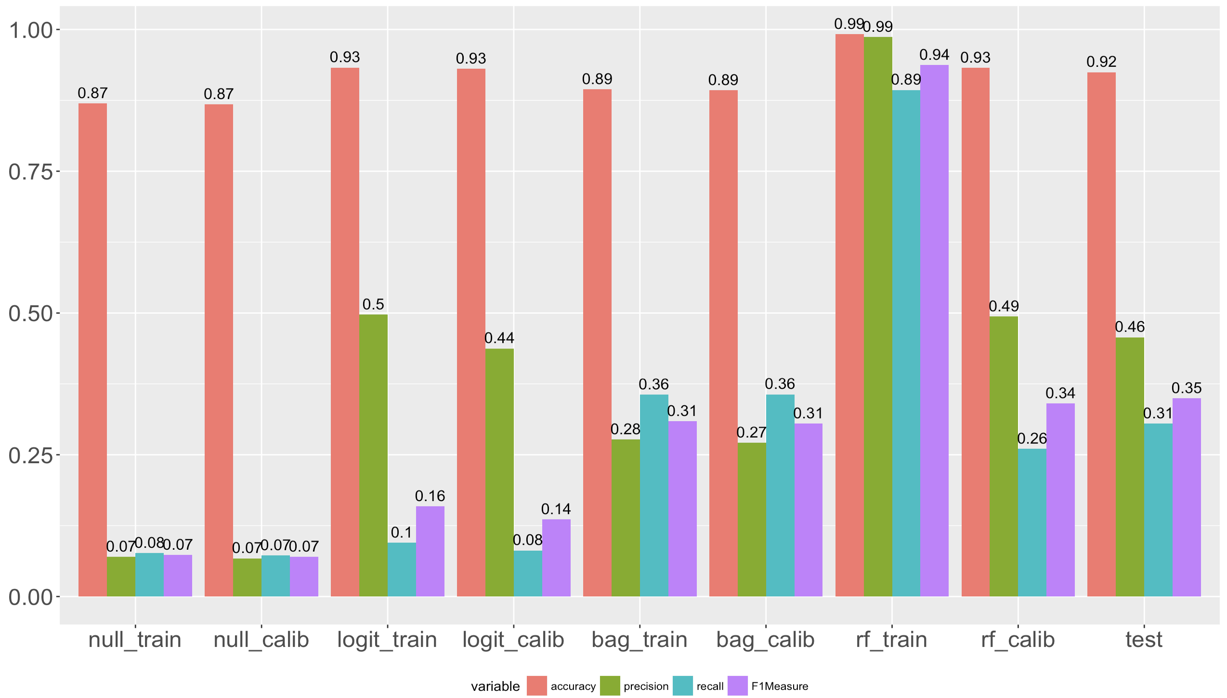
Performance

Slide 21
Github
https://github.com/YuTaNCCU/1061_DS_FP_106356013_KKBoxChurnPrediction

Slide 22
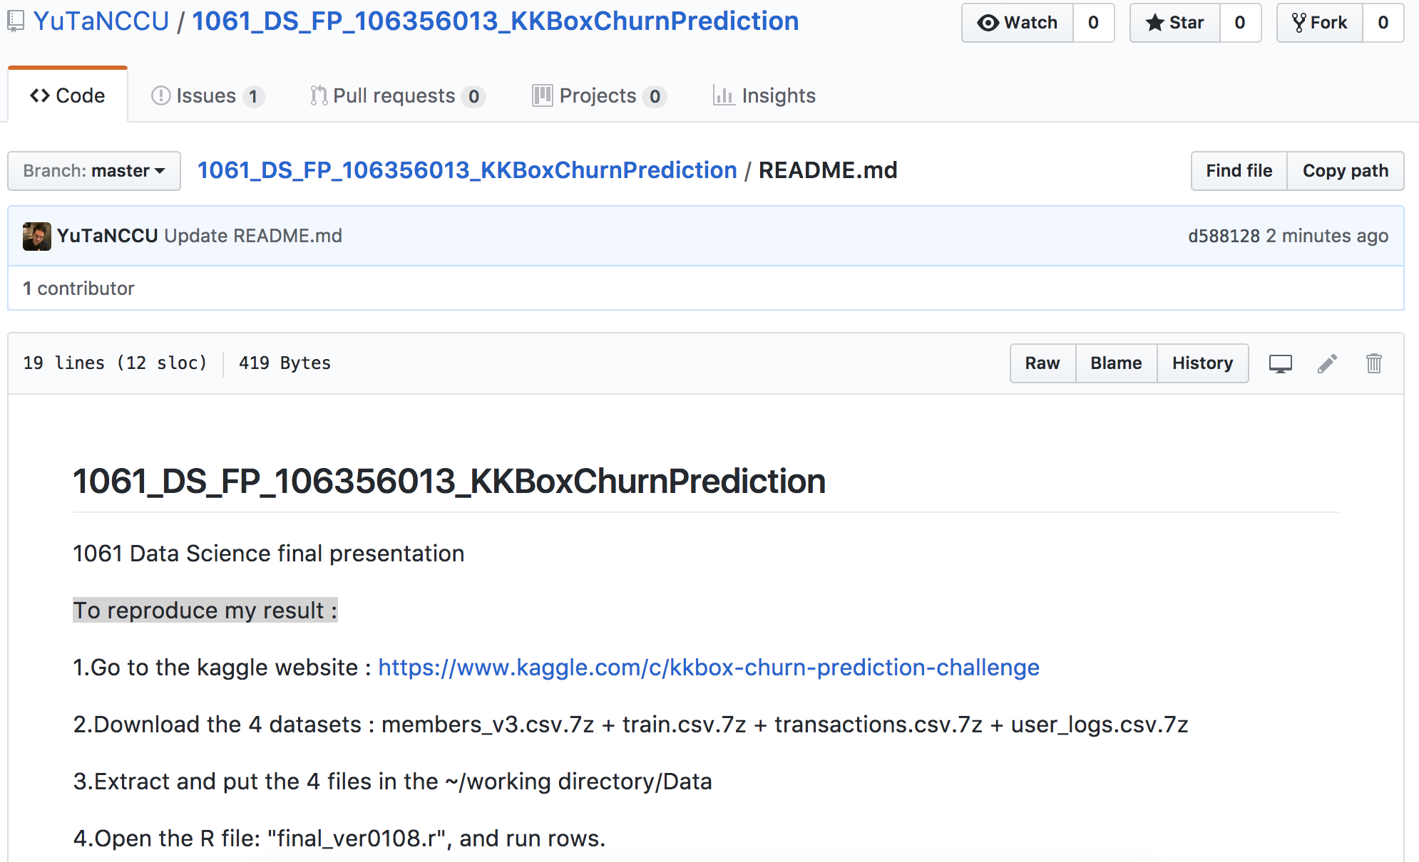
To reproduce my result :
https://github.com/YuTaNCCU/1061_DS_FP_106356013_KKBoxChurnPrediction/blob/master/README.md

Slide 23
What is the challenge part of your project?

